Slide 1
NOW HIRING!
Jackson’s Superheroes, Incorporated

Slide 2
Rotating Jobs

Slide 3
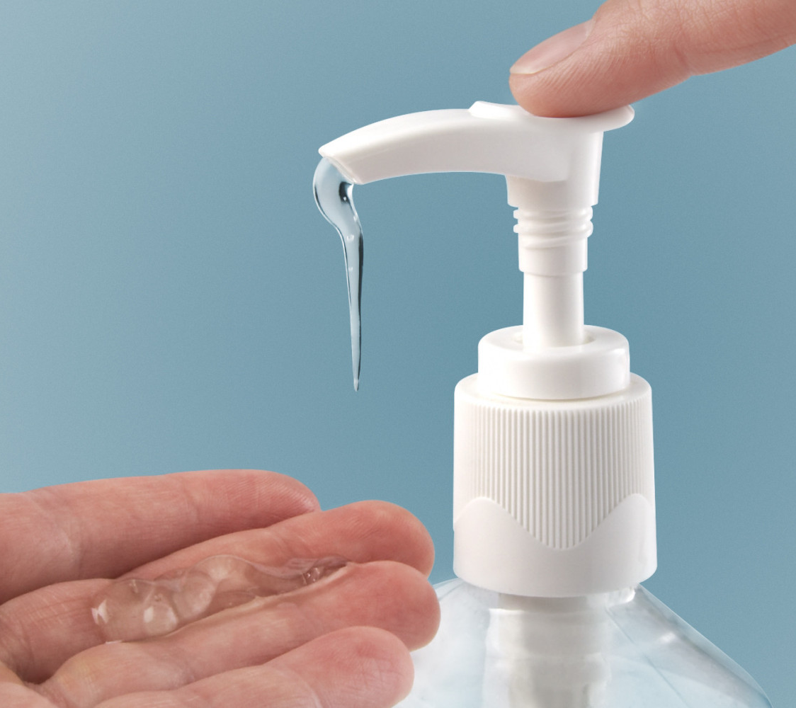
Hand Sanitizer
Before lunch and after recess, give one squirt of sanitizer to every student.

Slide 4

Go Noodle Coordinator
Pick GoNoodle brain breaks each day.

Slide 5

Caboose
When we leave the classroom, turn off the lights and crack the door closed. Walk at the end of the line to ensure no one is left.

Slide 6
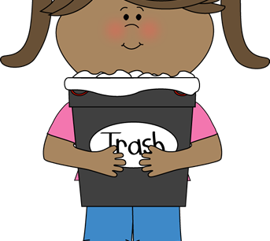
Sanitation Helper
At the end of the day, double check the classroom floors for scraps and make sure our garbage cans are sitting by the front door.

Slide 7
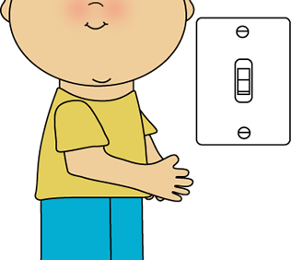
Electrician
Turn the lights on and off.

Slide 8
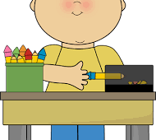
Pencil Monitor
Sharpen any pencils in the “Dull” bucket and place them in the “Sharp” bucket when they are sharp.

Slide 9

Table Washer
During Pack and Stack, wipes down all tables.

Slide 10

Line Leader
Each time our class lines up, lead the line quietly to our destination.

Slide 11

Attendance Monitor
Take attendance to the front office daily.

Slide 12
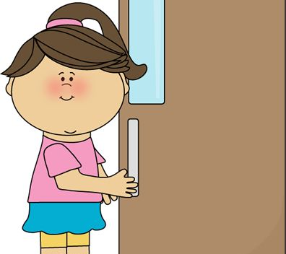
Door Opener
Open the door when we have visitors or someone is returning the room. Open all doors as we are leaving and entering our different destinations.

Slide 13

Sweeper
At the end of the day, sweep the classroom floor.

Slide 14

Messenger
Make deliveries to and from the classroom. Escort students to the office as needed.

Slide 15

Cubby Inspector
Check to make sure everyone’s cubby is nice and neat after Pack and Stack.

Slide 16

Board Eraser
Erase the board at the end of the day, except for the schedule. Every Friday, use a wipe to clean the trays of the whiteboards.

Slide 17

Gardener
Take care of all class plants.

Slide 18
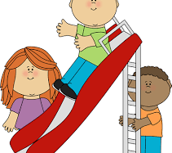
Recess Monitor
Keep up with all recess activities and games.

Slide 19
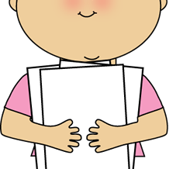
Paper Manager
Pass out materials while carefully listening to the directions for the assignment.

Slide 20

Meteorologist
Check the weather every morning during calendar.

Slide 21

Pet Caretaker

Slide 22
Permanent Jobs

Slide 23

Class Monitor
When the class is at lunch and specials, ensure that all students are on their best behavior.

Slide 24

Librarian
At the end of the day, make sure the library is neatly organized and that all books are on the correct shelf.

Slide 25
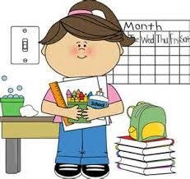
Aesthetic Assistant
Double-check that our classroom is tidy and ready for a fresh day of learning.

Slide 26
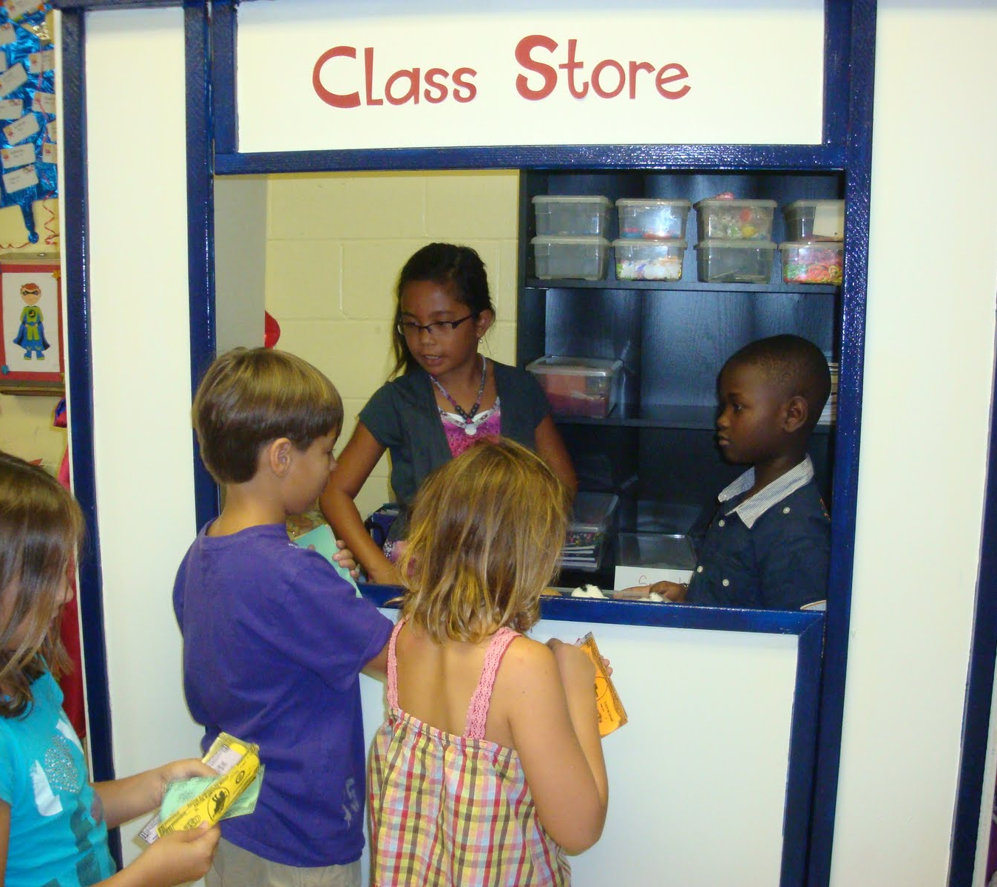
Coupon Collector
Work with the banker to pass out coupons as students buy them. Record their purchases. Collect coupons that students use. Record it in the binder.

Slide 27

Class Photographer
Take pictures and videos of all classroom activities.

Slide 28

Teacher’s Assistant
Help the teacher or substitute teacher with anything he or she may need done.

Slide 29

Substitute
Fill in for any jobs that are vacant.

Slide 30
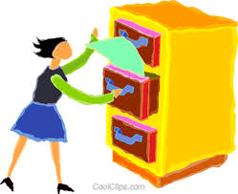
Filing Assistant
During Pack and Stack, put a stamp on all papers in the “Please Stamp” file and return to cubbies.

Slide 31
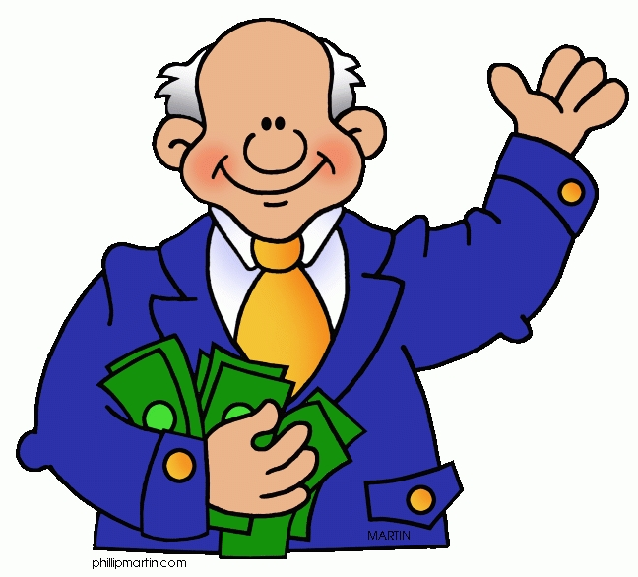
Banker
Pay each employee for his/her job on Friday during Pack and Stack.

Slide 32
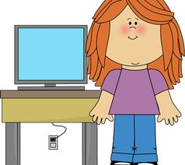
Technology Assistant
At the end of the day, make sure all computer are turned off and iPads are returned to the cart on Friday.

